Slide 1

Department of Electronics & Communication
Engineering
PORTABLE SELF ASSESSMENT AUDIOMETER USING RASPBERRY PI
Batch No: B08
Domain: Embedded and IOT
Guided By: Mr.A.Shafeek M.E., AP(SS)/ECE
Presented By,
1. S.Naveen (727622BEC110)
2. S.Pranesh (727622BEC018)
3. M.Adhil (727622BEC114)

Slide 2
Contents
01. INTRODUCTION
02. PROBLEM STATEMENT
03. OBJECTIVES
04. ABSTRACT
05. LITERATURE SURVEY
06. BLOCK DIAGRAM
07. TOOLS TO BE USED FOR IMPLEMENTING
THE PROJECT

Slide 3
Contents
08. VALIDATION AND FEEDBACK:
MEETING WITH ENT DOCTOR
09. MEETING WITH AUDIOLOGIST
BALACHANDRAN
10. WORKING MODEL
11. RESULT
12. CONCLUSION
13. REFERENCES

Slide 4
Introduction
Hearing loss is a common problem, especially for older adults.
It can make it hard to hear and talk to others.
Current hearing tests need a doctor and special rooms, which can be expensive and inconvenient.
This project created a portable hearing test anyone can use at home.
This could help people find out about hearing loss earlier and easier.

Slide 5
Problem Statement
The project aims to develop a portable audiometer for hearing self-assessment, addressing the limitations of conventional audiometers.
This cost-effective and user-friendly solution improves access to early detection and treatment of hearing loss, benefiting hearing-impaired individuals.

Slide 6
Objectives
Develop a portable audiometer for self-assessment.
Automate the hearing test process for efficiency.
Create a user-friendly interface using Python.
Generate accurate audiograms and store data effectively.
Notes:
e

Slide 7
Abstract
This study introduces a portable audiometer for self-assessment of hearing impairment, leveraging Raspberry Pi and Python. Users receive sound signals via headphones, responding with a patient button.
An automatic audiogram aids assessment, with results digitally stored. A familiarization process ensures user understanding, and the Hughson Westlake procedure enhances efficiency.

Slide 8
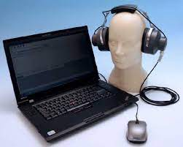
Abstract
Leveraging open-source Python minimizes software development costs. This innovative approach offers accessible and cost-effective hearing screening for elderly and hearing-impaired individuals.

Slide 9
Literature survey
Sl. No | Authors | Title of the paper | Journal | Year | Key points
1 | Ritu Rani; H.T. Patil | Portable audiometer for detecting hearing disorder at an early stage for cancer patient | IEEE | 2016 | Early detection, hearing loss,
2 | Marwa Gargouri; Mondher Chaoui; Patrice Wira | Development of hearing self-assessment pure tone audiometer | IEEE | 2020 | Self-test, hearing check, tones

Slide 10
Literature Survey
Sl. No | Authors | Title of the paper | Journal | Year | Key points
3 | M.Dharani kumar Chowdhary | A novel raspberry pi-3 based pure tone audiometer and verification of calibration with standard system | Journal of Data Acquisition and Processing | 2020 | Calibration, Raspberry Pi
4 | Silvia Figueira; Kevin Nguyen | HearThat? - An app for diagnosing hearing loss | IEEE | 2019 | Home test, Hearing check, App

Slide 11
Block diagram

Slide 12
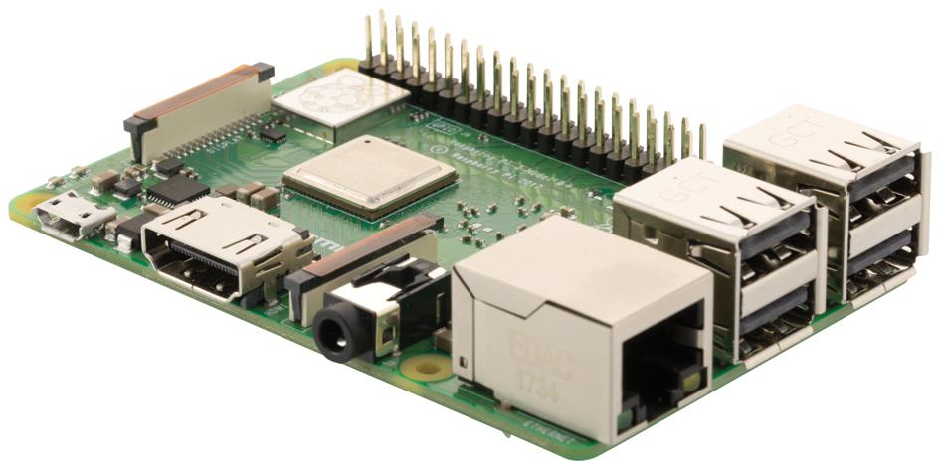
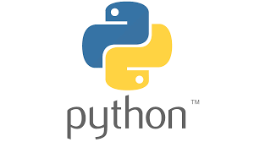
Tools to be used for Implementing the project
Hardware:
Raspberry Pi 3 B+:
Interfaces with peripherals and runs the system.
Headphones:
Connected to the Raspberry Pi for delivering pure tone signals.
Mouse:
Connected to a USB port on the Raspberry Pi, used as the patient response button.
Software:
Operating System: Runs on Raspberry Pi
Python Programming Language

Slide 13
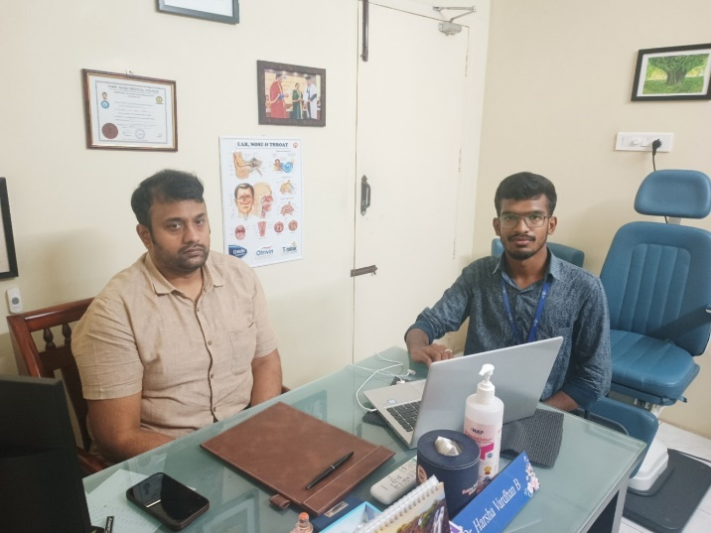
Validation and Feedback: Meeting with ENT Doctor
Consultation With Dr. B. Harsha Vardhan, M.S. Ent (Otolaryngology)
To develop a portable audiometer for self-assessment of hearing loss, we sought input from Dr. B. Harsha Vardhan, an ENT expert, to gather practical insights and evaluate the device's effectiveness. Dr. Vardhan provided valuable guidance and feedback on the project

Slide 14
Discussion with the ENT Doctor:
During the meeting, we discussed the project and demonstrated the functionality of the pure tone audiometer.
Dr. Vardhan praised the project, considering it highly promising.
He expressed interest in purchasing the pure tone audiometer once it is completed
We learned that the market value of a commercial pure tone audiometer is approximately 1.50 lakhs.
Feedback was given on making minor adjustments to the audiogram's x and y-axis for improved accuracy
The audiologist advised us to test the self-assembled pure tone audiometer with individuals who are hearing impaired for further validation.

Slide 15
Recommendation to Meet an Audiologist:
Dr. Vardhan recommended meeting with an audiologist in Pollachi for further validation of the device.
He provided contact details of an audiologist in Pollachi for additional consultation.
Feedback and Conclusion:
Dr. Vardhan appreciated the innovative project and participated in testing the audiometer.
The project received positive feedback overall, with suggestions for minor adjustments to enhance accuracy.
Collaboration with medical professionals validated the effectiveness of the self-assembled pure tone audiometer, reinforcing its potential utility

Slide 16
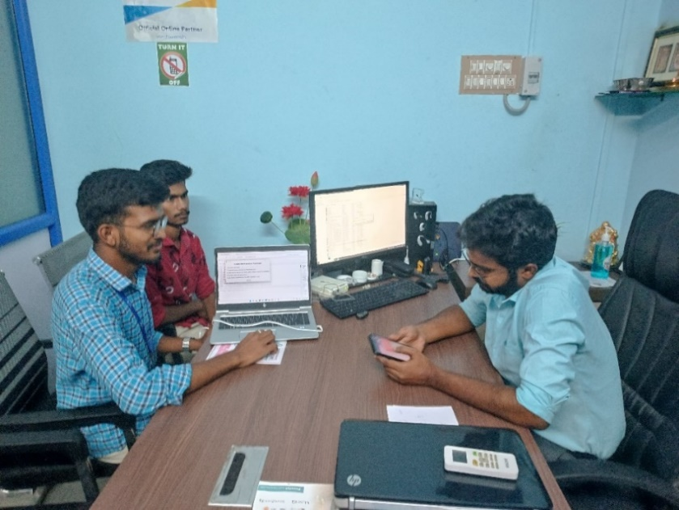
MEETING WITH AUDIOLOGIST BALACHANDRAN
Consultation with Dr. P. Balachandran, ASLP
To develop a portable audiometer for self-assessment of hearing loss, we sought input from Dr. P. Balachandran, , an Audiologist expert, to gather practical insights and evaluate the device's effectiveness. Dr. Balachandran provided valuable guidance and feedback on the project

Slide 17
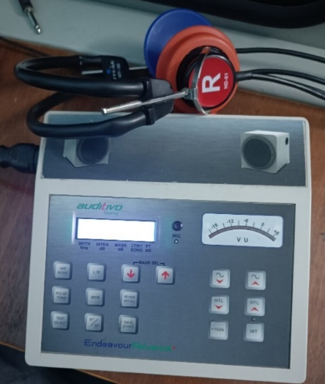
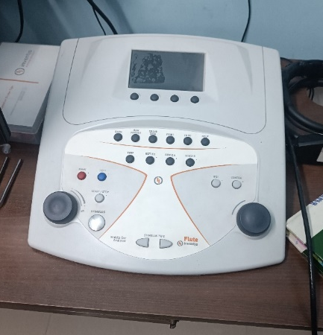
PROJECT DISCUSSION
Balachandran provided valuable insights and suggestions for enhancing our project.
He emphasized the importance of including a bone conduction test to accurately plot the audiogram and describe hearing loss.
He also recommended replacing the standard headphones with TDH49, which are specifically designed for audiometry tests. Furthermore, he suggested printing the audiogram sheet for proper documentation
He introduced me to essential audiology testing equipment, including the Auditivio Audiometer (Endeavour), an Indian product priced at ₹50,000, and the imported Flute Inventis Tympanometer, which costs ₹4.50 lakhs

Slide 18
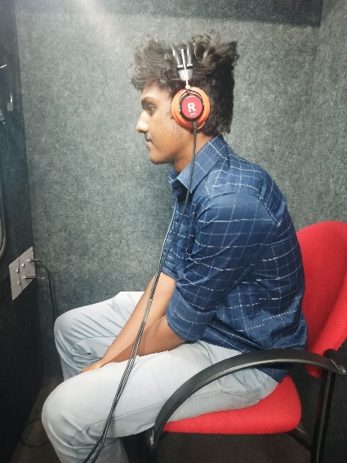
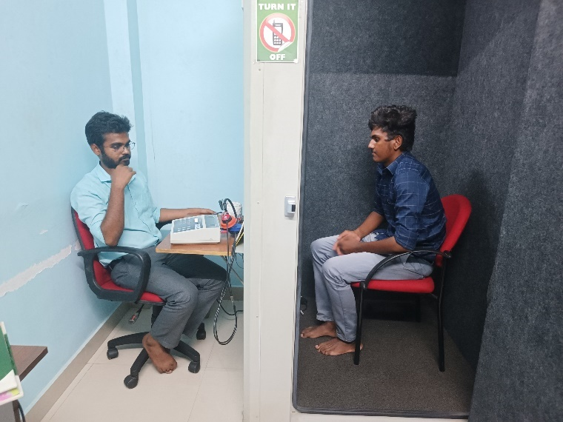
AUDIOMETRY TEST

Slide 19
KEY FEEDBACK FROM AUDIOLOGIST
Bone Conduction Tests: Essential for accurate audiogram plotting and describing hearing loss.
TDH49 Headphones: Recommended replacing standard headphones with TDH49 for audiometry tests.
Printed Audiogram Sheets: Necessary for proper documentation.
Calibration Levels: Explore and implement sound pressure level calibration for accuracy.
Intensity and Time Delay Adjustments: Needed for better test accuracy
Maximum Frequency Intensity: Research the maximum frequency intensity levels.
TDH49 Headphone Characteristics: Study crossover and ear level responses.
Cost-Effectiveness: Compare the project’s cost-effectiveness with pure tone audiometers.

Slide 20
KEY FEEDBACK FROM AUDIOLOGIST
Mackenzie Audiometry Test: Consider incorporating or adapting principles from this test
High-Frequency Audiometry Tests: Extend capabilities to include high-frequency audiometry tests.
Enhanced User Interface: Improve user interface for better usability.
Real-Time Data Analysis and Feedback: Integrate real-time data analysis and feedback features for immediate results.
KEY FEEDBACK FROM AUDIOLOGIST
GUIDANCE AND LEARNING
Balachandran recommended the book "Auditory Diagnosis" by Robert and requested a hard copy of our project documentation.
We provided him with detailed study material. He also explained the Mackenzie audiometry test, highlighting its significance.

Slide 21
EXPLORATION AND FUTURE SCOPE
Balachandran educated us on high-frequency audiometry tests and provided guidance for further development of our project. He offered detailed insights into masking tests, cross-level intensity, and various types of audiometry, and explained the concept of hearing loss.
CONCLUSION
The meeting with Balachandran was incredibly enlightening. We gained valuable insights into potential improvements and future prospects for our project.
His expertise in audiometry testing and his recommendations were instrumental in enhancing our understanding and guiding our project's direction.

Slide 22
EXISTING VS PROPOSED SELF-ASSESSMENT AUDIOMETERS

Slide 24
PORTABLE AUDIOMETER (RASPBERRY PI) VS
MOBILE HEARING TEST

Slide 26
Results
The developed portable audiometer successfully allows for self-assessment of hearing impairment. Utilizing a Raspberry Pi 3 B+, headphones, and patient response button, it facilitates efficient testing. The system produces an automatic audiogram based on patient responses, saving data in CSV files for analysis.
After consulting an ENT doctor and audiologist, minor adjustments were made to improve accuracy. Testing with both professionals and hearing-impaired individuals yielded promising results. While the audiometer's output differed slightly from conventional devices, it effectively detected hearing impairments. The cost-effective Python programming language facilitated software development, enhancing accessibility.

Slide 27
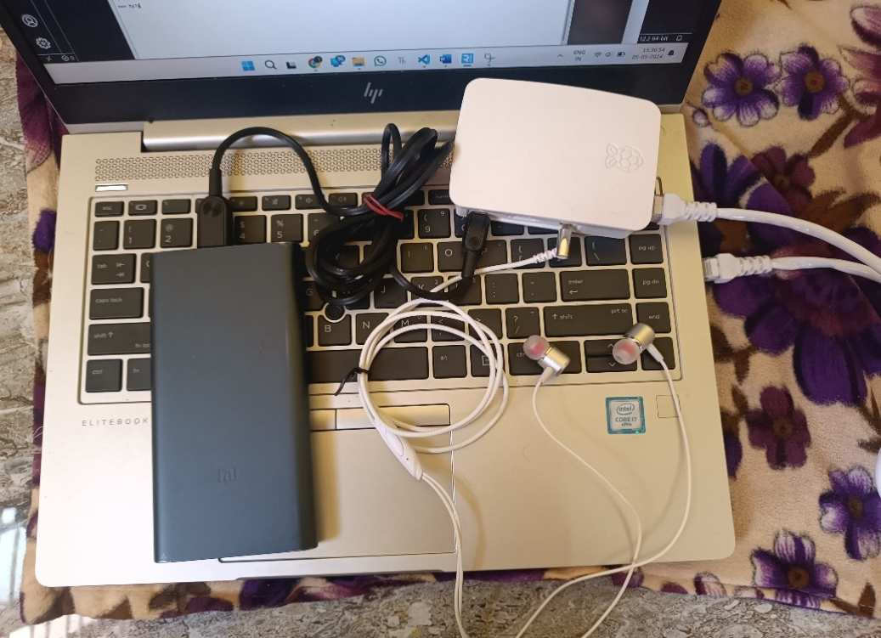
Results
Overall Initialization Pure Tone Audiometer

Slide 28
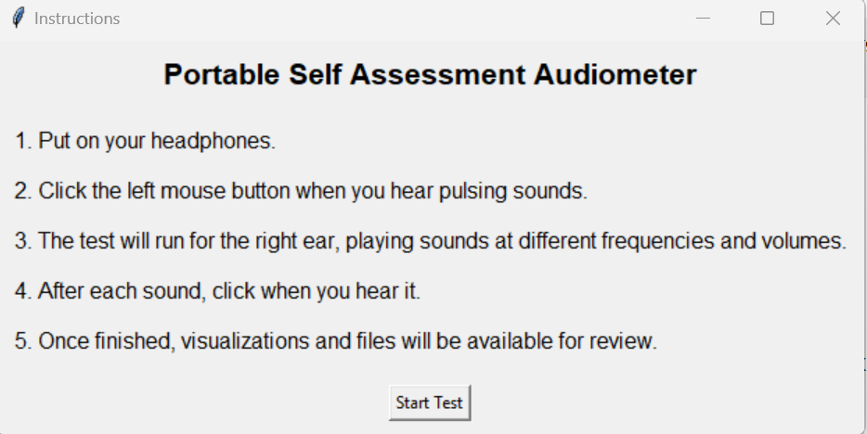
Results
Instruction of the project

Slide 29
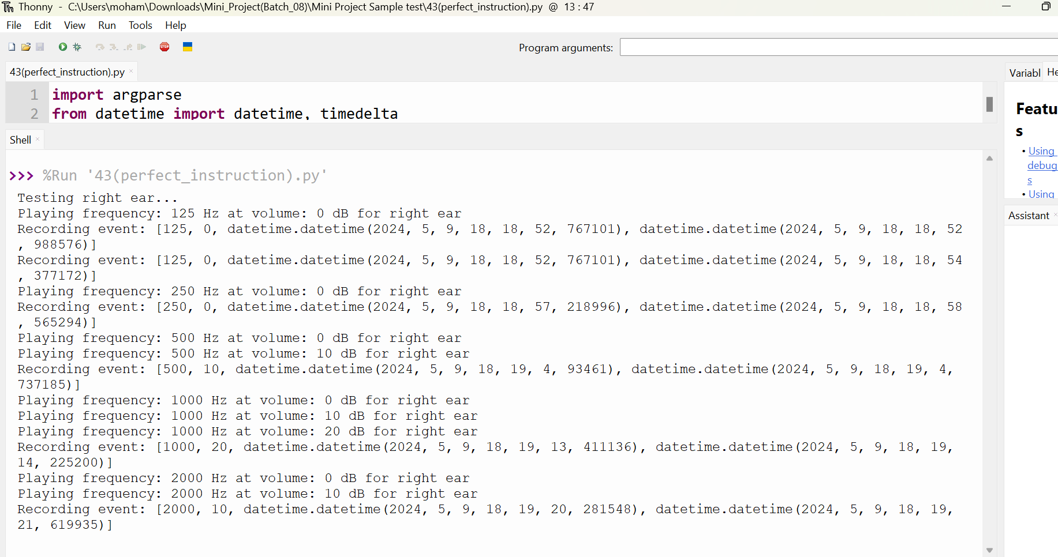
Results
Patient Response of the Audiometer

Slide 30
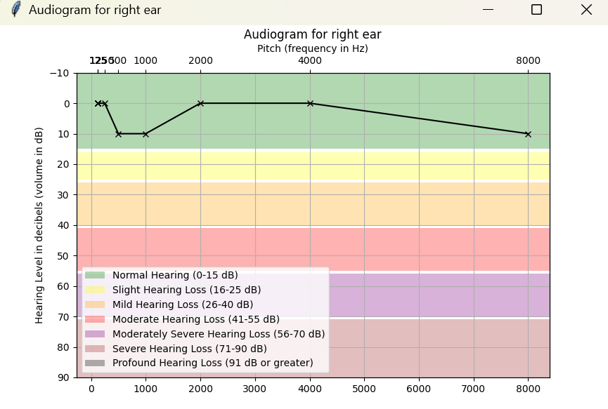
Results
Output of the Audiogram Chart

Slide 31
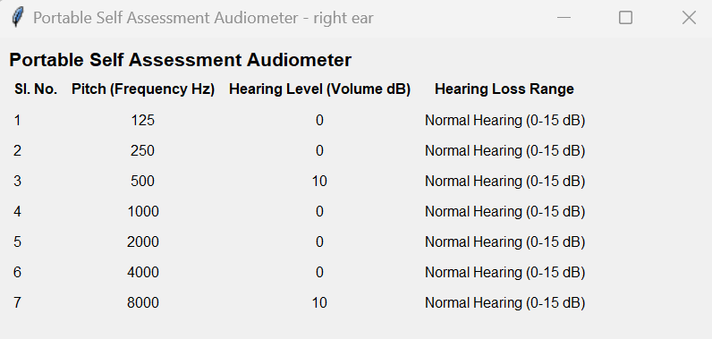
Results
Result Analysis

Slide 32
Conclusion
The portable audiometer is a cost-effective solution for self-assessing hearing impairment, saving time and money compared to traditional methods. Developed in collaboration with medical professionals, it is accurate and reliable, despite minor differences in sound quality.
Future improvements could focus on refining the device's sound output. This project highlights the potential for affordable healthcare technologies that empower individuals to manage their health effectively.

Slide 33
References
”Ritu Rani; H.T. Patil”, “Portable audiometer for detecting hearing disorder at an early stage for cancer patient”, “2016 International Conference on Automatic Control and Dynamic Optimization Techniques”.
“Marwa Gargouri;, Mondher Chaoui” ,“Development of hearing self-assessment pure tone audiometer, “2020 IEEE International Conference on Design & Test of Integrated Micro & Nano-Systems (DTS)”

Slide 34
References
“M.Dharani kumar Chowdhary, Dr. C. Nagaraja ”,” A novel raspberry pi-3 based pure tone audiometer and verification of calibration with standard system, “Journal of Data Acquisition and Processing(2020)”.
“Silvia Figueira; Kevin Nguyen; Shweta Panditrao”,
“HearThat? - An app for diagnosing hearing loss”, “IEEE Global Humanitarian Technology Conference (GHTC 2019)”.

Slide 35
